Slide 1
Parker Solar Probe
To be included in the website

Slide 2
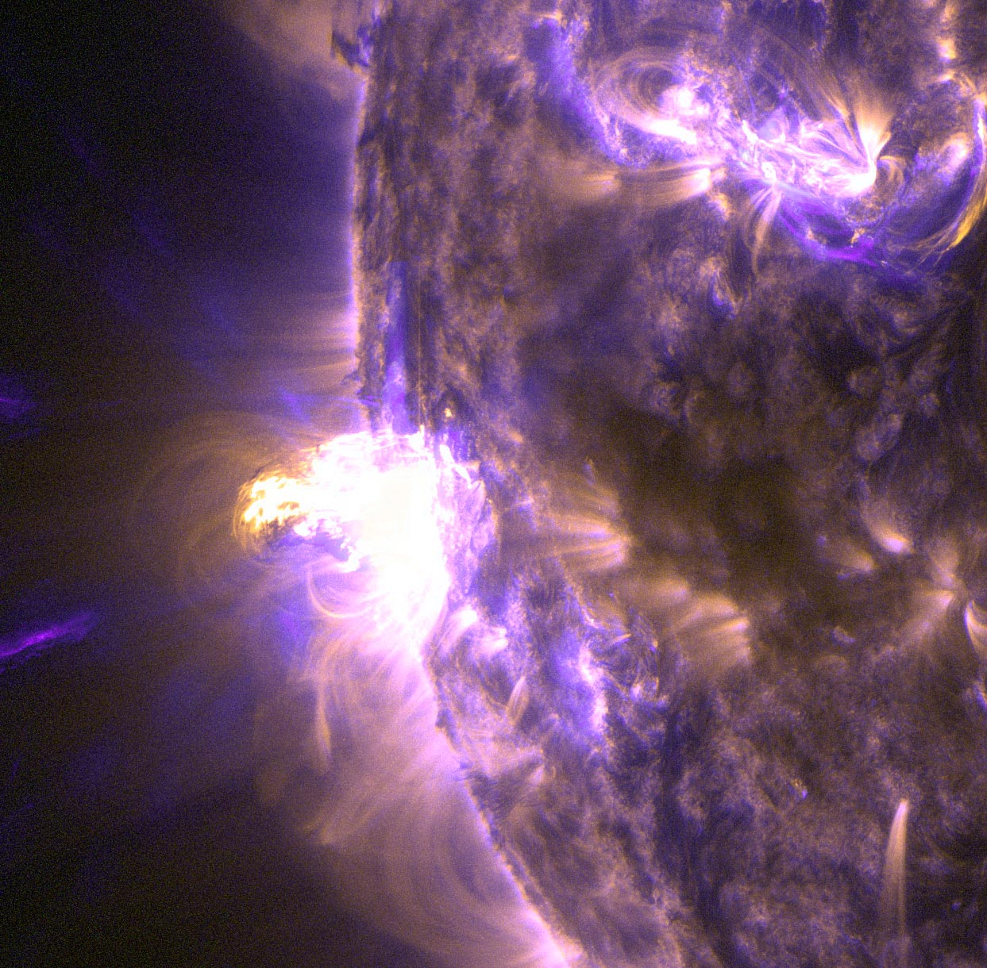
Why do we need it?
Our closest star, the sun is actually a very huge ball of hot gas continuously undergoing fusion reaction to generate heat and light which is key to support life here on earth.
However, there has been recent discoveries of some phenomena occurring on sun which can potentially harm all living beings here on earth.
Solar wind is one such example, with potential to disrupt the geomagnetic field of earth, it becomes very hazardous to humanity considering how the humanity of 21st century is overly dependent on electricity and satellites.

Slide 3
ENGINEERING

Slide 4
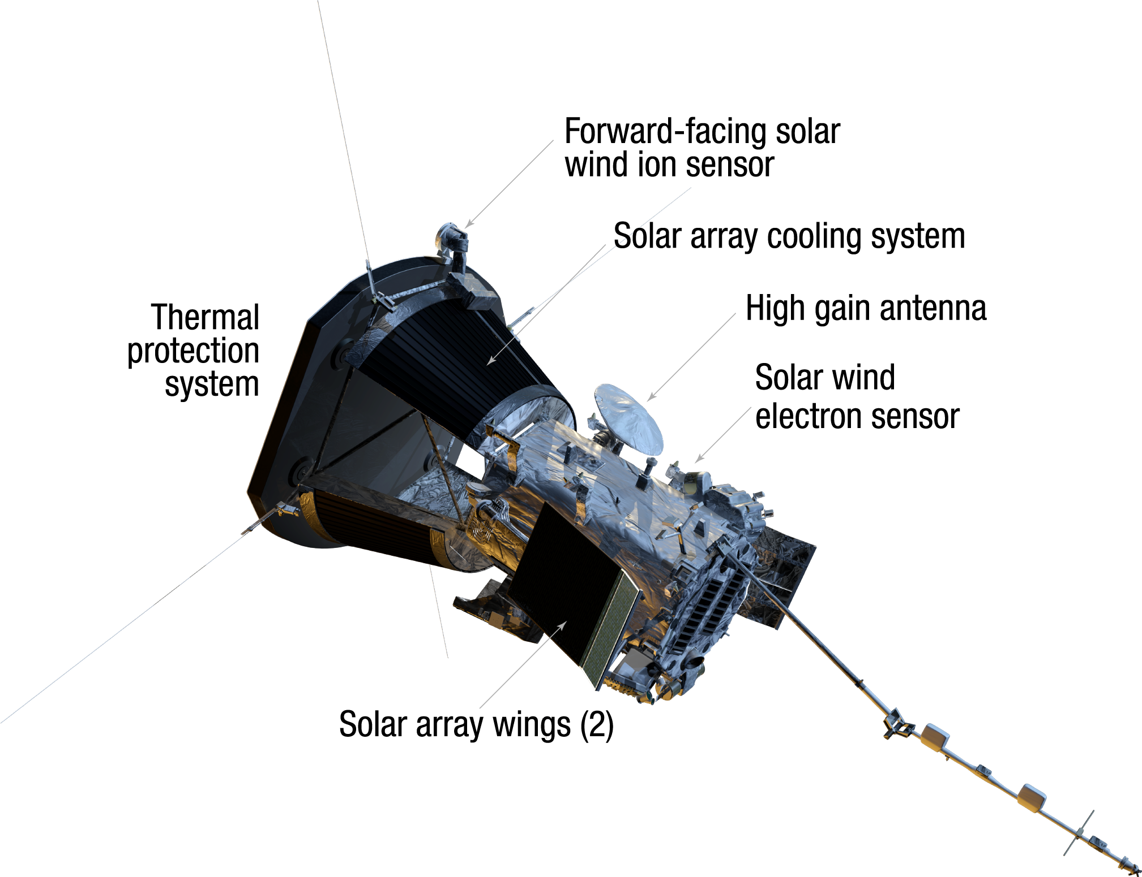
Anti-Ram Facing View

Slide 5
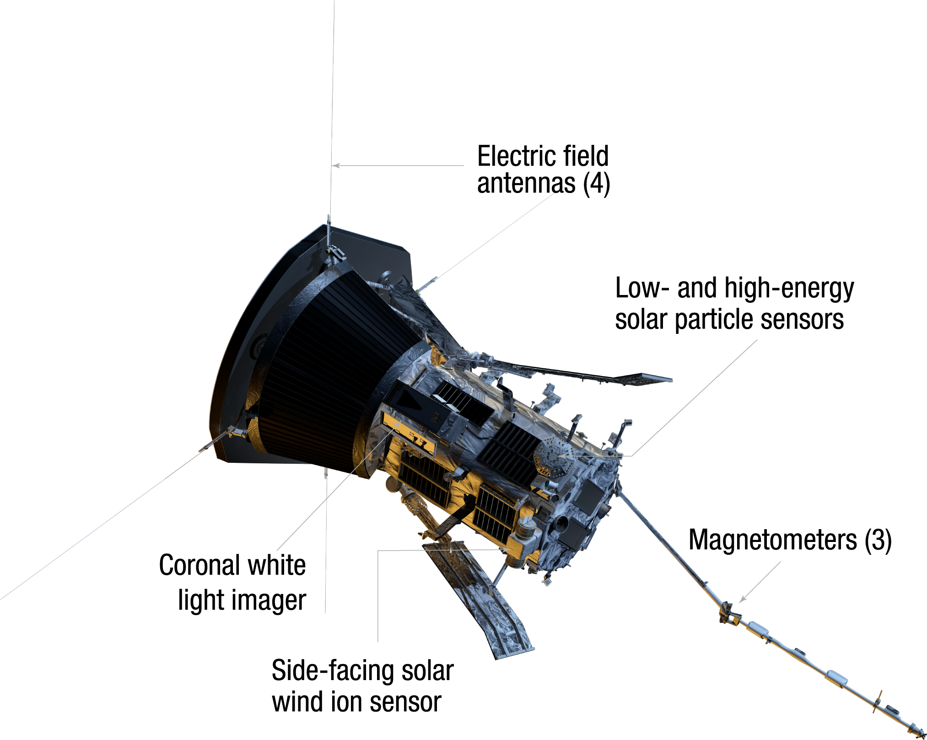
Ram Facing View

Slide 6
INSTRUMENTS

Slide 7
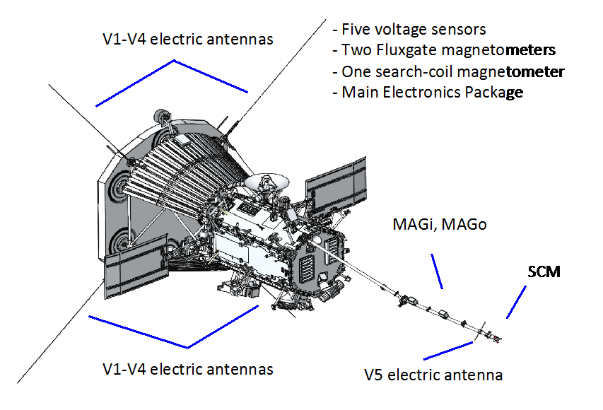
Fields Experiment (FIELDS):
This investigation will make direct measurements of electric and magnetic fields and waves, Poynting flux, absolute plasma density and electron temperature, spacecraft floating potential and density fluctuations, and radio emissions.

Slide 8
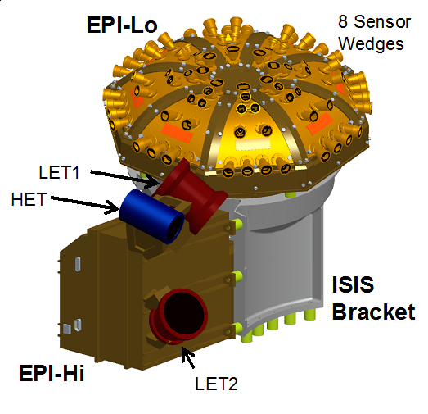
Integrated Science Investigation of Sun (ISꙨIS)
This investigation makes observations of energetic electrons, protons and heavy ions that are accelerated to high energies (10s of keV to 100 MeV) in the Sun's atmosphere and inner heliosphere, and correlates them with solar wind and coronal structures.

Slide 9
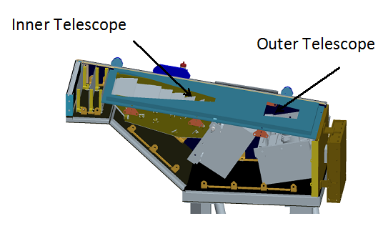
Wide field Imager for Solar PRobe (WISPR)
These telescopes will take images of the solar corona and inner heliosphere. The experiment will also provide images of the solar wind, shocks and other structures as they approach and pass the spacecraft. This investigation complements the other instruments on the spacecraft providing direct measurements by imaging the plasma the other instruments sample.

Slide 10
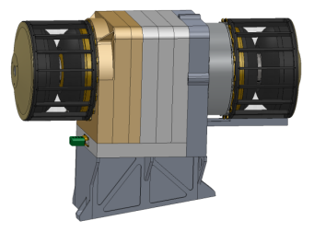
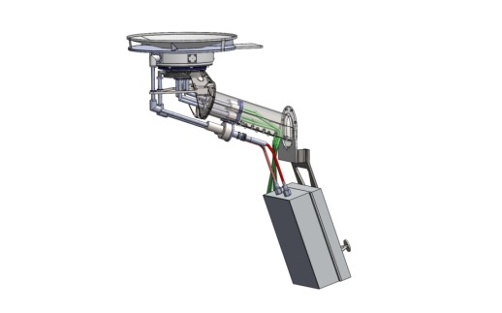
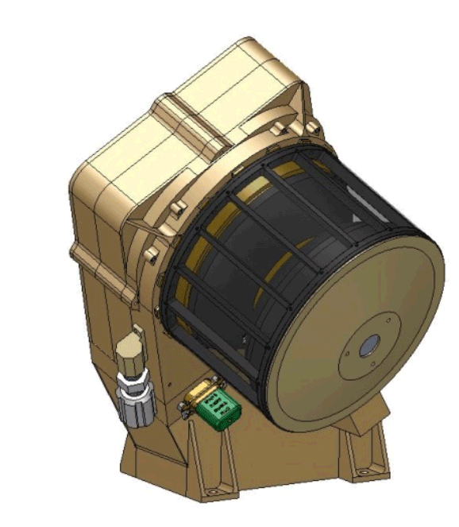
Solar Wind Electrons Alphas and Protons (SWEAP) Investigation
This investigation will count the most abundant particles in the solar wind -- electrons, protons and helium ions -- and measure their properties such as velocity, density, and temperature.
SPAN-A+
SPC
SPAN-B

Slide 11
How does it get to Sun?

Slide 12
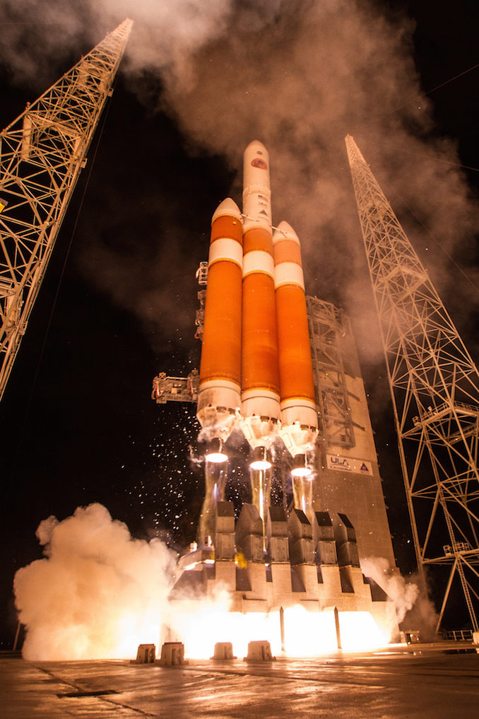
Launch
Launch date: 12 August 2018
Launch time: 3:31AM (EDT)/ (7:31 UTC)
Launch Vehicle: ULA Delta IV Heavy (with a third stage for additional ∆v)
Stage performance: All stages performed nominally.

Slide 13
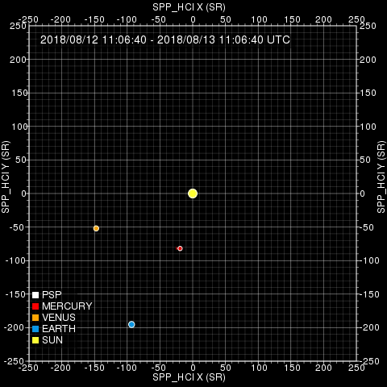
Orbit and Trajectory
The mission objectives needs the probe to make 24 orbits around the Sun and 7 Venus flyby for gravity assist. This would accelerate the probe to reach a maximum speed of approx. 690,000km/h (0.064% of speed of light)
Closest approach: 6.9 million km

Slide 14
Accomplishment of the mission* *to be updated on 3rd Oct according to most recent data

Slide 15
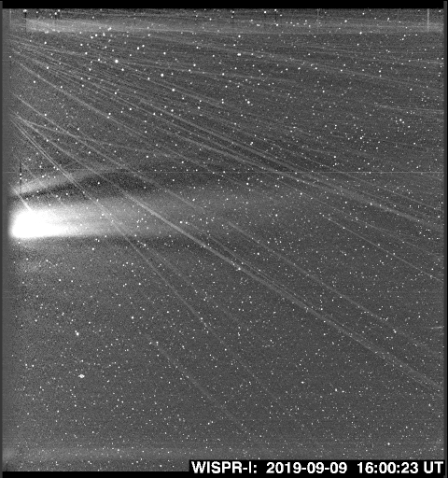
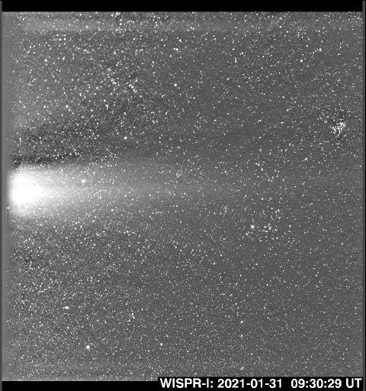
Dust free zones
Clear evidence of the dust-free zone around the Sun, supporting the initial hints of such a zone published in the 2019 Nature papers.

Slide 16
Diverse kinetic and magnetohydrodynamic aspects of plasma — such as wave-particle interactions, magnetic field reconnection, and turbulence — pertinent to the heating and acceleration of the solar wind.
New results about large-scale solar wind structures, such as coronal mass ejections and stream interaction regions, and the often-associated solar energetic particles.

